Slide 1
THE INDIGENT REPRESENTATION SYSTEM
Indigent Representation Fund
Pam Hancock, Fiscal Services Director
Administrative Office of the Courts
Rule 13 and Pertinent Tennessee Statutes
David Byrne, Assistant General Counsel
Administrative Office of the Courts

Slide 2
INDIGENT REPRESENTATION FUND PAM HANCOCK Fiscal Services Director

Slide 3
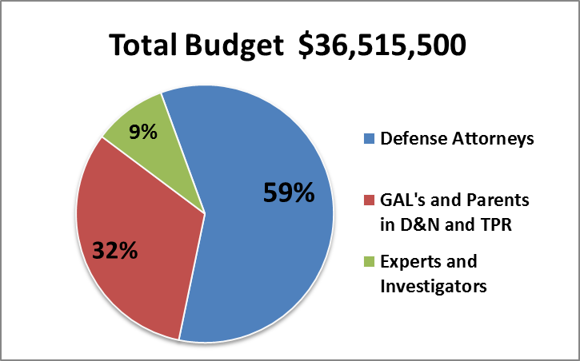

Slide 6
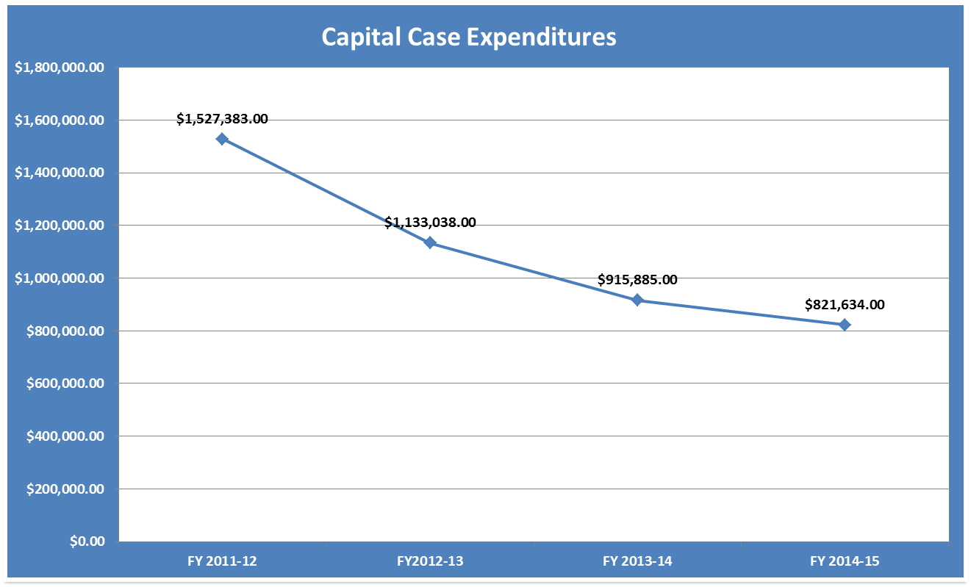

Slide 8
RULE 13 AND PERTINENT TENNESSEE STATUTES DAVID BYRNE Assistant General Counsel

Slide 9
INDIGENT PERS0NS DEFINED T.C.A. § 8-14-201 An “indigent person” is one who does not possess sufficient means to pay reasonable compensation for the services of a competent attorney:
In any criminal prosecution or juvenile delinquency proceeding involving a possible deprivation of liberty; or
In any habeas corpus or other post-conviction proceeding.

Slide 10
T.C.A. § 8-14-205(a) & (c) INDIGENCY; DETERMINATION; APPOINTMENT OF COUNSEL When any person appears without counsel before any court of this state exercising original jurisdiction upon a criminal prosecution or juvenile delinquency proceeding involving a possible deprivation of liberty, the court shall: 1. Inquire if person is financially able to employ counsel; 2. Conduct further examination to determine indigency; 3. Consider income, property, obligations, number and ages of dependents and any other matters deemed pertinent. 4. Reduce their determination of indigency to writing, sign, and file with papers of cause. If court of record, determination should be entered upon its official minutes.

Slide 11
APPOINTMENT OF COUNSEL T.C.A. § 8-14-205(d)(1) & (d)(2) If indigency is determined and the right to counsel has not been waived: a. The court shall make and sign an order appointing a district public defender or such other appointed counsel as provided by law. b. The court shall enter an order directing the party to pay into the registry if it is determined that accused can pay all or a portion of fees for the court appointed representation. 1. The clerk shall collect all monies paid and shall receive a 5% commission of all funds collected.

Slide 12
PUBLIC DEFENDERS AND INVESTIGATORS T.C.A. § 8-14-202(a), (b) and (c) (a) Creation of Offices (b) Terms of Office (c) Service Restrictions
Notes:
Note for David: Refer to balance of statute. The Task Force may want to review this in its entirety.

Slide 13
RIGHT TO COUNSEL T.C.A. § 40-14-102
“Every person accused of any crime or misdemeanor whatsoever is entitled to counsel in all matters necessary for the person’s defense, as well to facts as to law.”

Slide 14
a. If unable to employ counsel, the defendant is entitled to have counsel appointed by the court. b. A defendant who is provided a court-appointed counsel shall be assessed a nonrefundable $50.00 administrative fee that can be waived or reduced if the defendant lacks the financial resources sufficient to comply and can be increased not to exceed $200.00 if there is sufficient means. c. Clerk collecting administrative fees shall report the fee statistics to AOC monthly.
INDIGENT DEFENDANTS; APPOINTMENT OF ATTORNEY; ASSESSMENT OF ADMINISTRATIVE FEES
(T.C.A. § 37-1-126(c)(1) or § 40-14-103)

Slide 15
THE RIGHT TO COUNCIL IN JUVENILE PROCEEDINGS – T.C.A. § 37-1-126(a)(1) A child is entitled to representation by legal counsel at all stages of any delinquency proceedings or proceedings alleging unruly conduct that place the child in jeopardy of being removed from the home pursuant to § 37-1-132(b) and is entitled to a guardian ad litem for proceedings alleging a child to be dependent and neglected or abused.

Slide 16
T.C.A. 37-1-126(2)(A) An adult is entitled to representation by legal counsel at all stages of any proceeding under this part in proceedings involving: (i) Child abuse prosecutions pursuant to §§ 37-1-412 and 39-15-401; (ii) Contributing to the delinquency or unruly behavior of a child pursuant to § 37-1-156 or contributing to the dependency and neglect of a child pursuant to § 37-1-157; (iii) Violation of compulsory school attendance pursuant to §§ 49-6-3007 and 49-6-3009; or (iv) Criminal contempt.

Slide 17
T.C.A. 37-1-126(B) A parent is entitled to representation by legal counsel at all stages of any proceeding under this part in proceedings involving: (i) Abuse, dependency or neglect pursuant to § 37- 1-102; or (ii) Termination of parental rights pursuant to § 36- 1-113.

Slide 18
Whenever an accused informs the court that the accused is financially unable to obtain the assistance of counsel, it is the duty of the court to conduct a full and complete hearing as to the financial ability of the accused to obtain assistance of counsel and, thereafter, make a finding as to the indigency of the accused. All statements made by the accused seeking the appointment of counsel shall be by sworn testimony in open court or written affidavit sworn to before the judge.
T.C.A. 40-14-202

Slide 19
WHEN MAKING A FINDING AS TO THE INDIGENCY OF AN ACCUSED, THE COURT SHALL TAKE INTO CONSIDERATION:
The nature of the services rendered;
The usual and customary charges of an attorney in the community for rendering like or similar services;
The income of the accused regardless of source;
The poverty level income guidelines compiled and published by the United States Department of Labor;
The ownership or equity in any real or personal property;
The amount of the appearance or appeal bond, whether the party has been able to obtain release by making bond, and, if the party obtained release by making bond, the amount of money paid and he source of the money; and
Any other circumstances presented to the court which are relevant to the issue of indigency.

Slide 20
COUNSEL FOR INDIGENT DEFENDANTS COMPENSATION AND SALARIES
T.C.A. § 40-14-206
T.C.A. § 40-14-207
The supreme court shall prescribe by rule the nature of the expense for which reimbursement may be allowed and the limitations on and conditions for reimbursement as it deems appropriate and in the public interest.
Other than public defenders and post-conviction defenders, attorneys appointed under this part shall be entitled to reasonable compensation for their services prior to trial, at trial, and during the appeal of the cause and shall be entitled to reimbursement for their reasonable and necessary expenses in accordance with the rules of the supreme court.

Slide 21
RULE 13: APPOINTMENT, QUALIFICATIONS, AND COMPENSATION OF COUNSEL FOR INDIGENT DEFENDANTS

Slide 22
THE PURPOSES OF RULE 13
To provide for the appointment of counsel in all proceedings in which an indigent party has a statutory or constitutional right to appointed counsel;
To provide for compensation of appointed counsel in non-capital cases;
To establish qualifications and provide for compensation of appointed counsel in capital cases, including capital post-conviction proceedings;
To provide for payment of expenses incident to appointed counsel’s representation;
To provide for the appointment and compensation of experts, investigators, and other support services for indigent parties in criminal cases, parental rights termination proceedings, dependency and neglect proceedings, delinquency proceedings, and capital post-conviction proceedings;
To establish procedures for review of claims for compensation and reimbursement of expenses.

Slide 23
RIGHT TO COUNSEL AND PROCEDURE FOR APPOINTMENT OF COUNSEL
All general sessions, juvenile, trial, and appellate courts shall appoint counsel to represent indigent defendants and other parties who have a constitutional or statutory right to representation according to the procedures and standards set forth in this rule.

Slide 24
PARTIES WITHOUT COUNSEL SHALL BE ADVISED OF THE RIGHT TO REPRESENTATION AND THAT COUNSEL WILL BE APPOINTED UPON REQUEST IF FOUND INDIGENT IN THE FOLLOWING CASES:
Adult is charged with felony or a misdemeanor and is in jeopardy of incarceration;
Contempt of court proceedings where defendant is in jeopardy of incarceration;
Proceedings initiated by a petition for habeas corpus, early release from incarceration, suspended sentence, or probation revocation;
Proceedings initiated by a petition for post-conviction relief;

Slide 25
PARTIES WITHOUT COUNSEL SHALL BE ADVISED OF THE RIGHT TO REPRESENTATION AND THAT COUNSEL WILL BE APPOINTED UPON REQUEST IF FOUND INDIGENT IN THE FOLLOWING CASES:
Parole revocation proceedings;
Judicial proceedings dealing with Mental Health Law;
When a superintendent of mental health facility files a petition under the guardianship law;
Cases relative to petitions for waiver of parental consent for abortions by minors; and
Proceedings initiated pursuant to Tenn. R. Crim. P. 36.1 and which the trial court has determined that the motion states a colorable claim of relief.

Slide 26
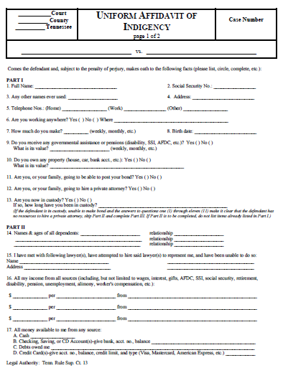
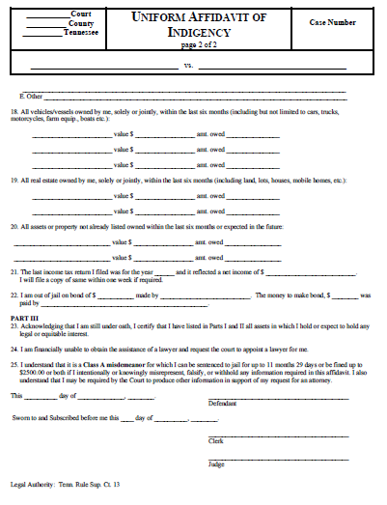
Under § 37-1-123(e)(1), whenever a party to any case in section 1(d) requests the appointment of counsel, the party shall be required to complete and submit to the court an Affidavit of Indigency Form provided by the
Administrative Office of the Courts (AOC).

Slide 27
The Court shall appoint a guardian ad litem when:
A child is the subject of a report of investigation of abuse or neglect.
A child is the subject of a proceeding to terminate parental rights.

Slide 28
MAXIMUM ATTORNEY COMPENSATION FOR
NON-CAPITAL MATTERS
$500
Contempt of court cases;
Parole Revocation;
T.C.A. Title 33 Judicial Proceedings (Chapters 3-8);
T.C.A. Title 34 Petitions;
Petitions for waiver of parental consent for abortions by minors (TSC Rule 24 and T.C.A. § 37-10-304; and
Cases alleging unruly conduct of a child (T.C.A. § 37-1-132(b));
$1,000
Preliminary hearings for adults in general sessions and municipal courts;
Adult or juvenile cases where there is a misdemeanor charge;
Direct and interlocutory appeals in the Court of Appeals or the CCA;
Direct and interlocutory appeals in the TSC;
Where defendant is applying for early release from incarceration or a suspended sentence;
Non-capital post-conviction and habeas corpus proceedings;
Probation revocation proceedings
Cases in which a juvenile is charged with a non-capital felony;
All other non-capital cases in which the indigent party has a statutory or constitutional right to be represented by counsel

Slide 29
$1,500
For cases in trial courts in which the defendant is charged with a felony other than first-degree murder or a Class A or B felony.
$2,000
For cases in trial courts in which the defendant is charged with first-degree murder of a Class A or B felony.

Slide 30
For Juvenile Dependency or Neglect Proceedings:
$750
Dependent or neglected child cases, from the filing of the dependency petition through the dispositional hearing, including the preliminary hearing, ratification of the initial permanency plan, adjudicatory and dispositional hearings;
Guardian ad litem representation and counsel appointed pursuant to TSC Rule 40(e)(2) for a child or sibling group who is or may be the subject of a report under TCA § 37-1-401 through § 37-1-411, from the filing of the dependency petition through the dispositional hearing, including the preliminary hearing, ratification of the initial permanency plan, adjudicatory and dispositional hearings.

Slide 31
$1,000
Dependent or neglected child cases, for all post-dispositional proceedings, including foster care review board hearings, post dispositional court reviews and permanency;
Guardian ad litem representation for all post-dispositional proceedings, including foster care review board hearings, post-dispositional court reviews, and permanency hearings; and
Counsel appointed pursuant to Tennessee Supreme Court Rule 409(e)(2) and in accordance with section for all post-dispositional proceedings, including foster care review board hearings, post-dispositional court reviews, and permanency hearings.
Proceedings against parents in which allegations against the parents could result in termination of parental rights;
Guardian ad litem representation in termination of parental rights cases; and
Counsel appointed pursuant to Tennessee Supreme Court Rule 40(e)(2) for a child or sibling group in termination of parental rights cases

Slide 32
SECTION 3: MINIMUM QUALIFICATIONS AND COMPENSATION OF COUNSEL IN CAPITAL CASES
(b)(1) The court shall appoint two attorneys to represent a defendant at trial in a capital case. Both attorneys appointed must be licensed in Tennessee and have significant experience in Tennessee criminal trial practice, unless in the sound discretion of the trial court, appointment of one attorney admitted under Tennessee Supreme Court Rule 19 is appropriate.
(c) Lead counsel must:
Be a member in good standing of the Tennessee bar and be admitted to practice pro hac vice;
Have regularly participated in criminal jury trials for at least five years;
Have completed, prior to the appointment, a minimum of six (6) hours of specialized training in the defense of defendants charged with a capital offense; and complete a minimum of six (6) hours of specialized training in the defense of defendants charged with a capital offense every two years thereafter;

Slide 33
SECTION 3: MINIMUM QUALIFICATIONS AND COMPENSATION OF COUNSEL IN CAPITAL CASES (continued)
(c) Lead counsel must:
Have at least one of the following:
Experience as lead counsel in the jury trial of at least one capital case;
Experience as co-counsel in the trial of at least two capital cases;
Experience as co-counsel in the trial of a capital case and experience as lead or sole counsel in the jury trial of at least one murder case;
Experience as lead counsel or sole counsel in at least three murder jury trials or one murder jury trial and three felony jury trials; or
Experience as a judge in the jury trial of at least one capital case.

Slide 34
SECTION 3: MINIMUM QUALIFICATIONS AND COMPENSATION OF COUNSEL IN CAPITAL CASES (continued)
(d) Co-counsel must:
Be a member in good standing of the Tennessee bar and be admitted to practice pro hac vice;
Have completed, prior to the appointment, a minimum of six (6) hours of specialized training in the defense of defendants charged with a capital offense; and complete a minimum of six (6) hours of specialized training in the defense of defendants charged with a capital offense every two years thereafter;
Have at least one of the following qualifications:
Qualify as lead counsel under (c) above; or
Have experience as sole counsel, lead counsel, or co-counsel in a murder jury trial.

Slide 35
SECTION 3: MINIMUM QUALIFICATIONS AND COMPENSATION OF COUNSEL IN CAPITAL CASES (continued)
COMPENSATION
Type of Counsel | Location | Hourly Rate
Lead | Out of court | $75
Lead | In court | $100
Co-Counsel | Out of court | $60
Co-Counsel | In court | $80
Post-conviction | Out of court | $60
Post-conviction | In court | $80
Appointed pursuant to Section 3(i) | Out of court | $60
Appointed pursuant to Section 3(i) | In court | $80

